Slide 1
Clinton or Trump: Who got covered more in the New York Times?
Martin Roger Nkpwang Ze, Lars Mangel, Dominique Brouwer, Cassandra Sijtsma, Dianne Ocampo
University of Amsterdam

Slide 2
Introduction

Slide 3
Research Questions
Motivation
Questions:
How often are Hillary Clinton and Donald Trump mentioned on The New York Times as the Presidential Election nears its end?
Who is mentioned more, and is a higher number consistent with substantial coverage or tabloid coverage?

Slide 4
Methods
Scraping: search terms “Donald Trump” and “Hillary Clinton”
Limited timeline: August 1, 2016 to October 1, 2016

Slide 5
Datasets
API of The New York Times
Specific selection of the “Presidential Election of 2016” section in the New York Times.
API of The Guardian
US section of The Guardian.

Slide 6
Results

Slide 7
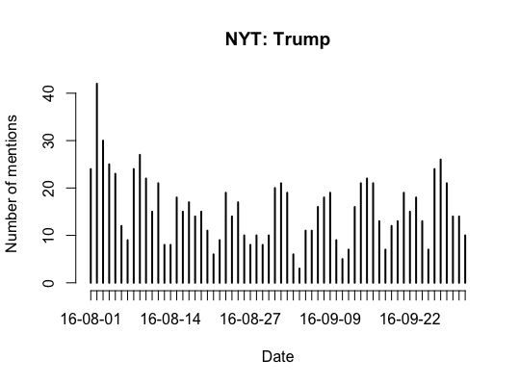
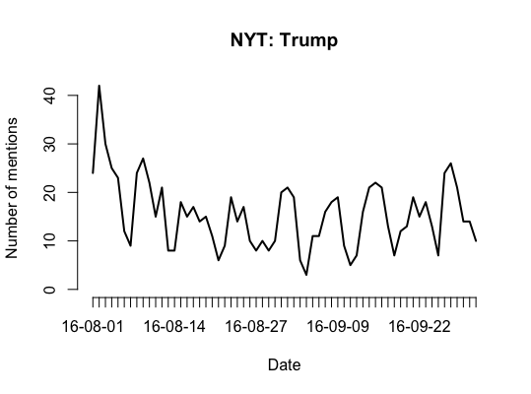
Trump in NYT

Slide 8
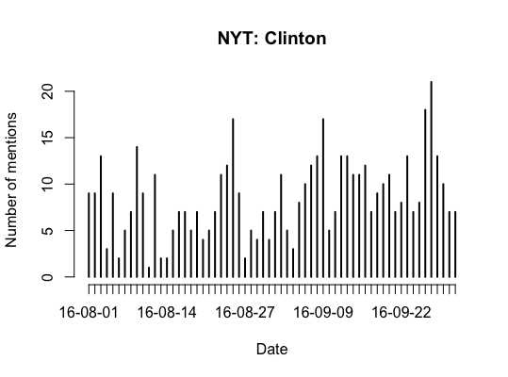
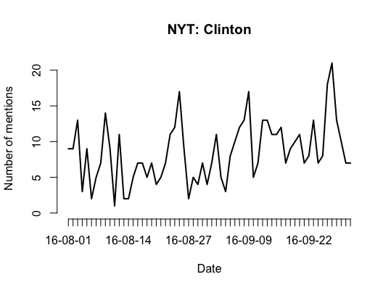
Clinton in NYT

Slide 9
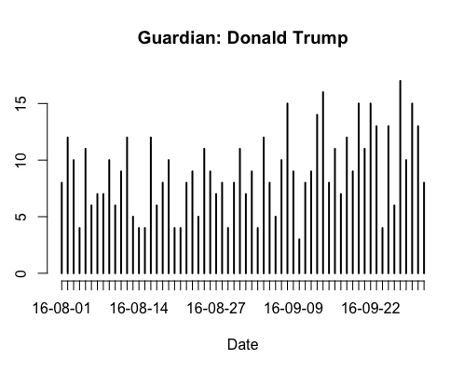
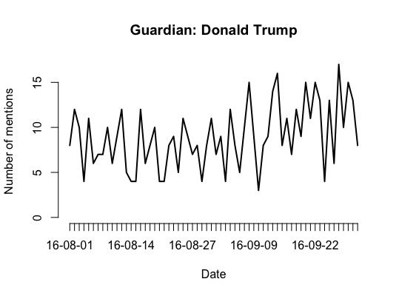
Trump in Guardian

Slide 10
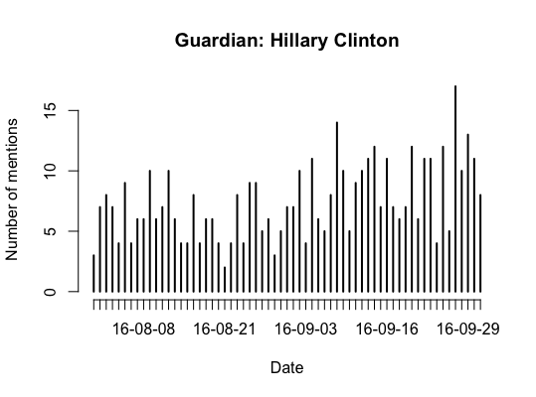
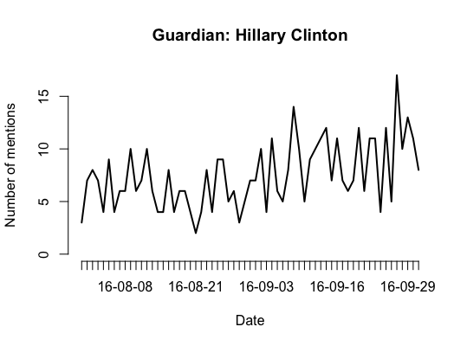
Clinton in Guardian

Slide 11
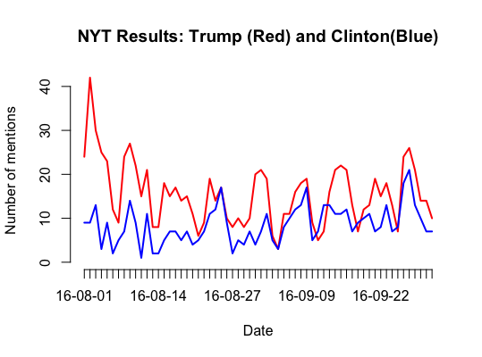
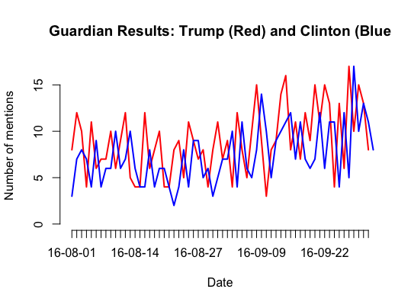
Side by side

Slide 12
Conclusion

Slide 13
Conclusion
Between Aug. 1, 2016 – Oct. 1, 2016
New York Times
Trump: 1291
Clinton: 757
Guardian
Trump: 533
Clinton: 468
Mentioning of Trump decreased nearing election date on the NYT. Clinton’s mentions increased.
The Guardian reflected our initial hypothesis that mentions for both candidates would increase near election day.

Slide 14
Future research
How can we follow this research up?
Provides the foundation for further investigation into the quality of news and media coverage during elections.
Can we expand on this research?
We could look deeper into the frequency comparison between Clinton and Trump and find a quantitative difference.
Useful other studies,

Slide 15
Clinton or Trump: Who got covered more in the New York Times?
Martin Roger Ze Schneider, Lars Mangel, Dominique Brouwer, Cassandra Sijtsma, Dianne Ocampo
University of Amsterdam

